Slide 1

Data Engineering Class 1 Introduction
Carlos De Oliveira
(Carlos.DeOliveira@NYU.edu)
Spring 2023

Slide 2
What you will learn
Explore the methods for summarizing
Collect and format data for analytical work
Assign data points into groups and visualize clustering patterns
Learn how to predict continuous and categorical outputs for data
Clean, filter noise from, and reduce the dimensions of data
In one sentence: data preparation for automation

Slide 3

What is Data Engineering?
Source:
Microsoft

Slide 4
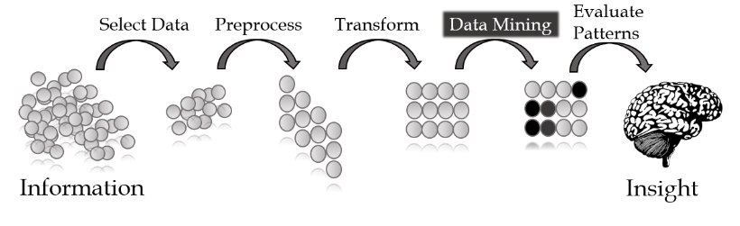
What is Data Engineering Today?
Source:
Microsoft

Slide 5
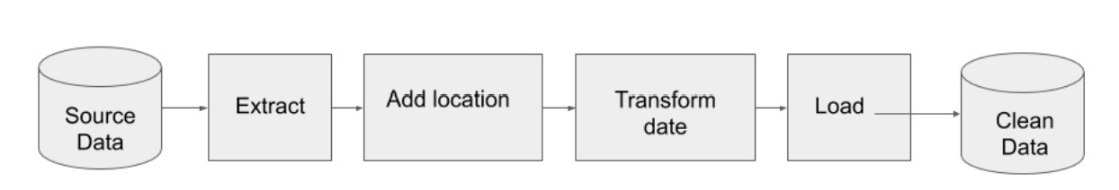
What is Data Engineering Tomorrow?
Extract
Transform
Load
Source:
Microsoft

Slide 6
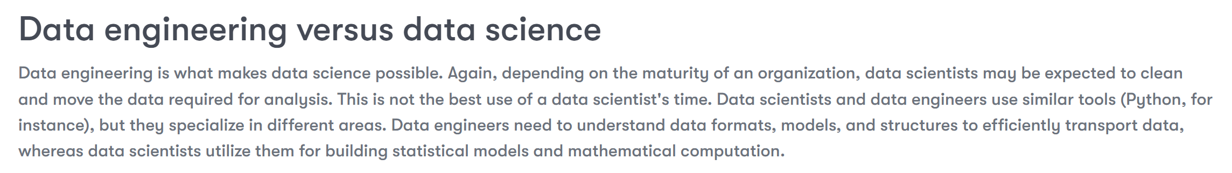
What is Data Engineering?
Source:
Microsoft

Slide 7
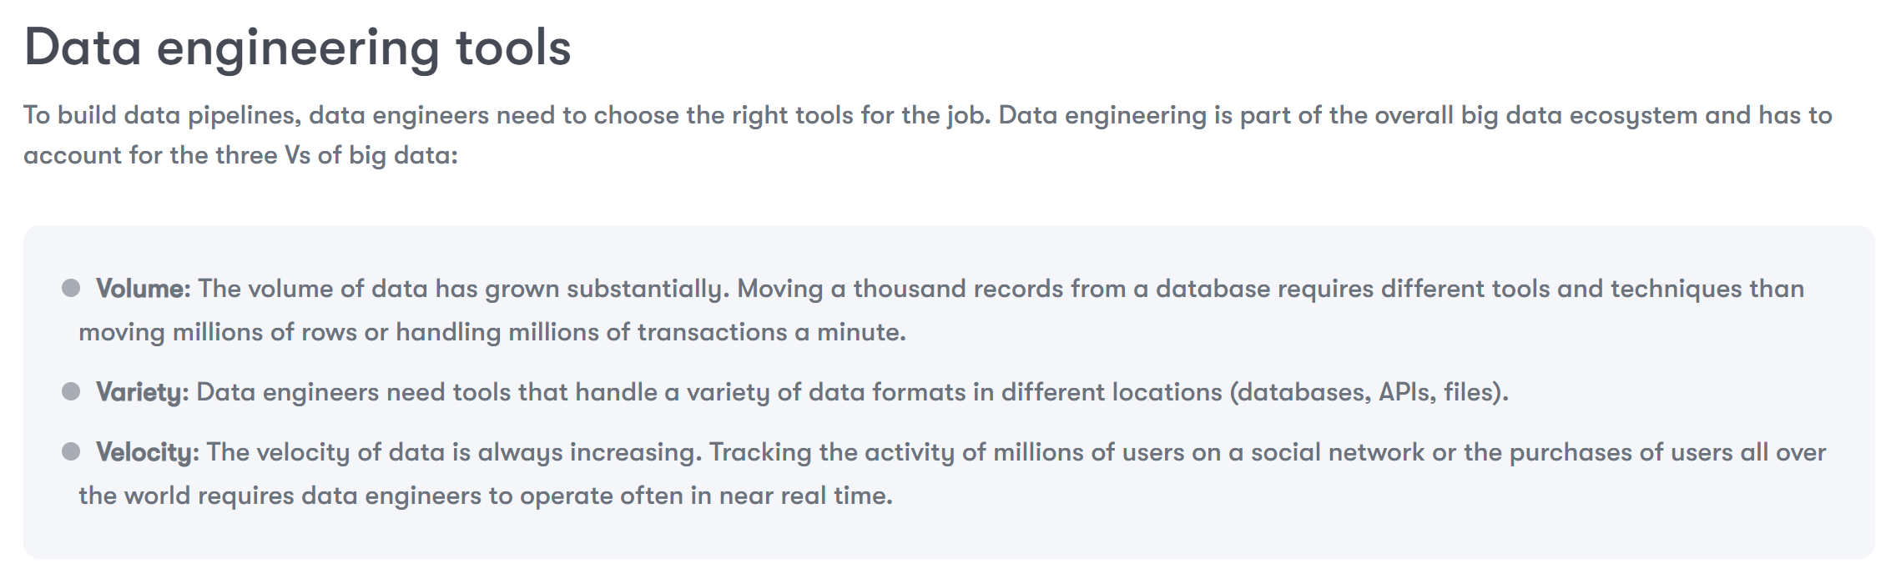
What is Data Engineering?
Source:
Microsoft

Slide 8
What is NumPy?
NumPy is the fundamental package for scientific computing in Python.
It is a Python library that provides:
A multidimensional array object,
Various derived objects (such as masked arrays and matrices), and
An assortment of routines for fast operations on arrays, including
Mathematical,
Logical,
Shape manipulation,
Sorting,
Selecting,
I/O,
Discrete Fourier transforms,
Basic linear algebra,
Basic statistical operations,
Random simulation, and
Much more

Slide 9
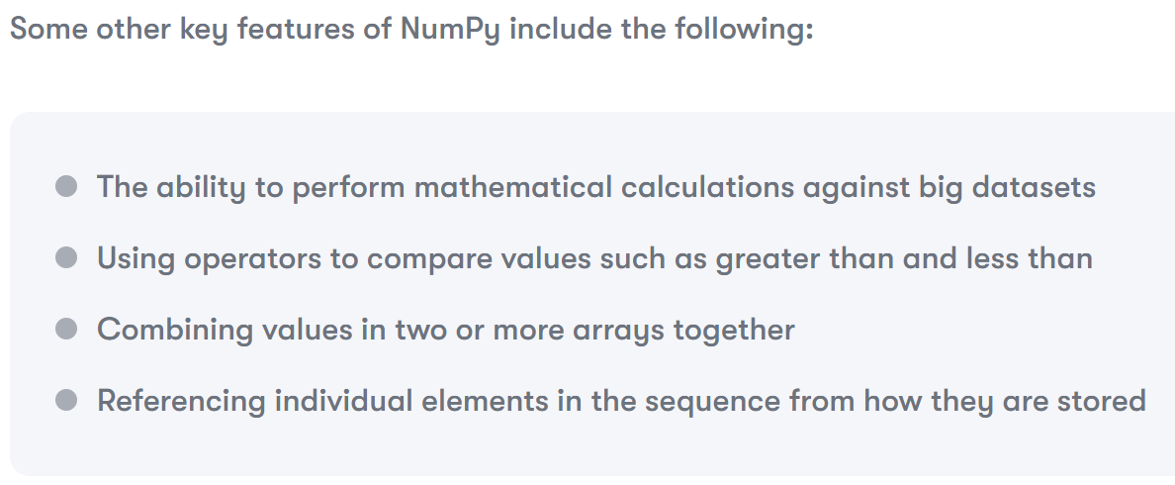
What is NumPy?

Slide 10


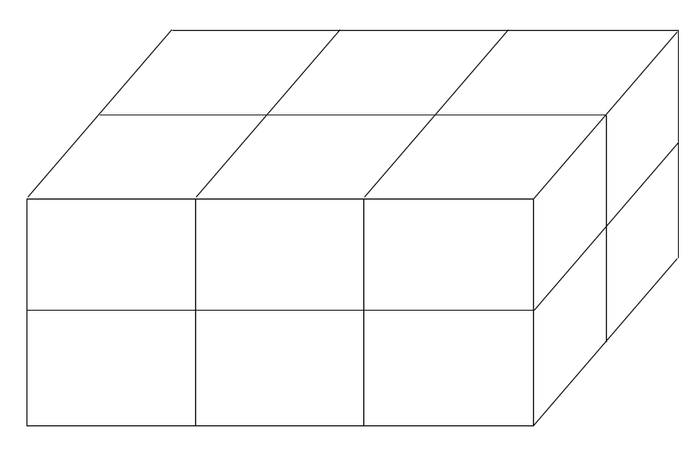
What is NumPy?
One-dimensional array with three elements
Two-dimensional array, which is also known as a matrix, with three elements
N-dimensional array could be represented as a cube
Examples

Slide 11
What is Pandas?
Pandas is a Python package providing fast, flexible, and expressive data structures designed to make working with “relational” or “labeled” data both easy and intuitive.
It aims to be the fundamental high-level building block for doing practical, real-world data analysis in Python.
Additionally, it has the broader goal of becoming the most powerful and flexible open-source data analysis/manipulation tool available in any language.
It is already well on its way toward this goal.

Slide 12
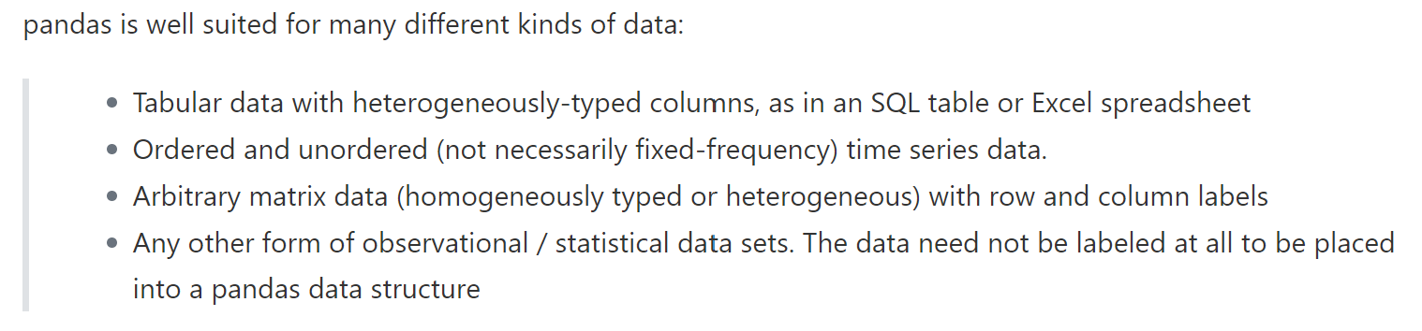
What is Pandas?
Pandas is the most powerful and flexible open-source data analysis/manipulation tool available

Slide 13
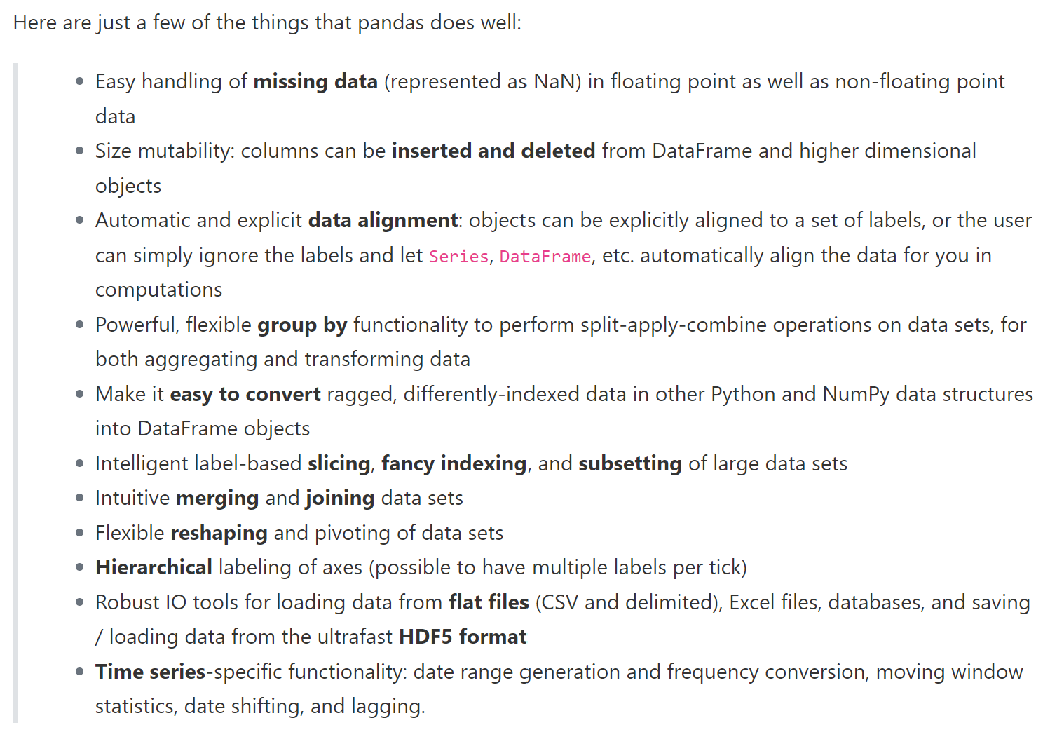
What is Pandas?

Slide 14
What is PyCaret?
PyCaret is an open-source, low-code machine learning library in Python that automates machine learning workflows.
It allows users to create and test regression models with just a few lines of code, as well as plot and do hyperparameter tuning.
https://pycaret.org/

Slide 15
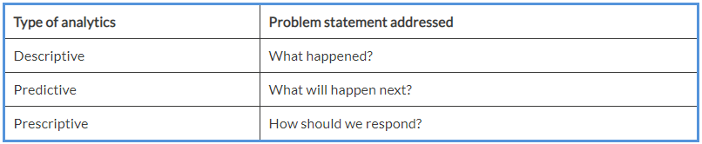
Descriptive, predictive, and prescriptive analytics
Practitioners in the field of data analysis usually break down their work into three genres of analytics, given as follows:
Nope!

Slide 16

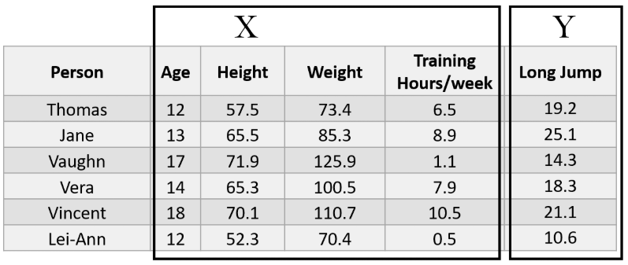
Variable types

Slide 17
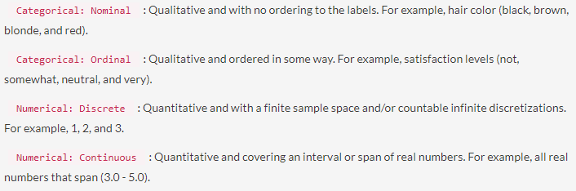
Data types

Slide 18
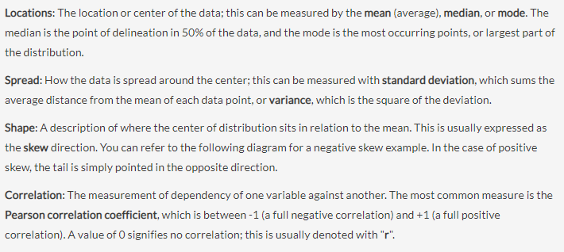
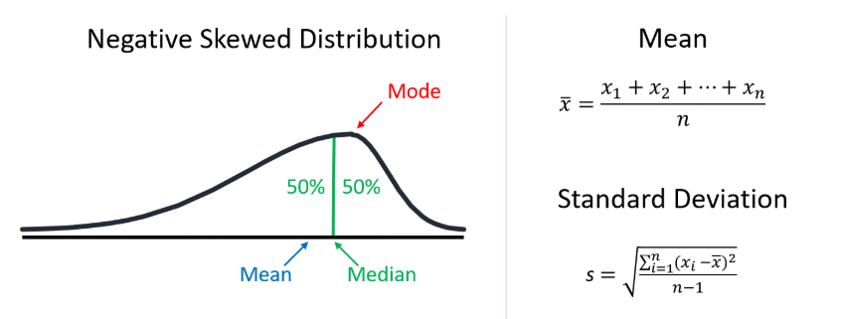
What is “Summary Statistics” ?

Slide 19
An example
Inspecting data – visualization/transformation tools
See EX 01.py → iris.csv
Subsequent examples will go into further details

